Slide 1
Five Years of Post-Grant Proceedings at the USPTO: Lessons Learned and Recent Developments in PTAB Practice
Quadeer A. Ahmed
February 18, 2018

Slide 2
Agenda
Statistics and Trends
Significant Developments at the PTAB
Guidance From the Federal Circuit
Questions?

Slide 3
Agenda
Statistics and Trends
Significant Developments at the PTAB
Guidance From the Federal Circuit
Questions?

Slide 4
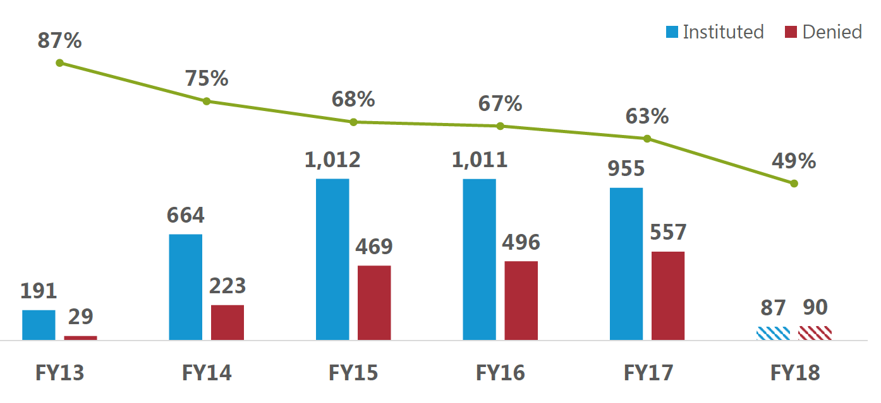
Statistics and Trends: Institution Rates
Source: USPTO (as of October 31, 2017)

Slide 5
Statistics and Trends: Technology Institution Rates
Source: USPTO (as of October 31, 2017)

Slide 6
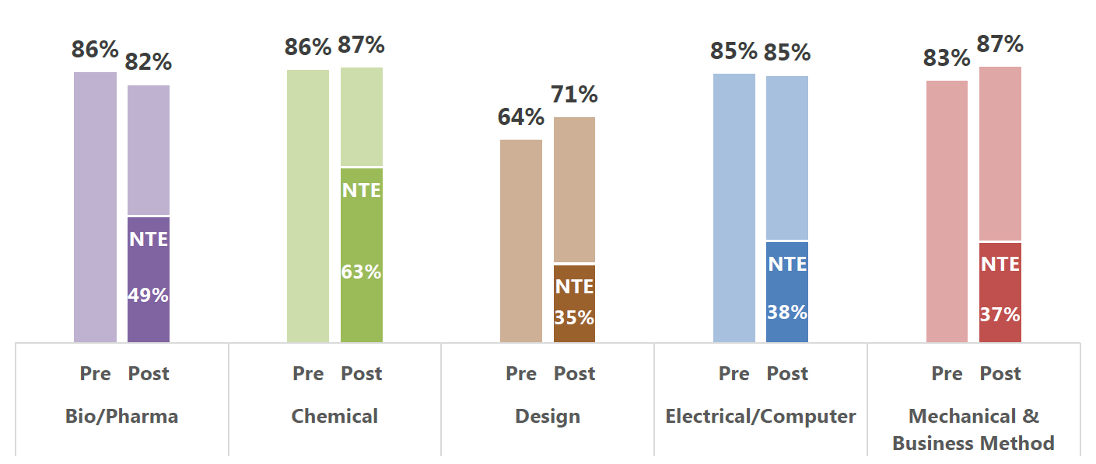
Statistics and Trends: Preliminary Responses and New Testimonial Evidence
Source: USPTO (as of October 31, 2017)

Slide 7
Statistics and Trends: Technology Filings
Source: USPTO (as of October 31, 2017)

Slide 8
Agenda
Statistics and Trends
Significant Developments at the PTAB
A Look Back at Common Pitfalls
Guidance on Sections 314(a) and 325(d)
Sovereign/Tribal Immunity
Guidance From the Federal Circuit
Questions?

Slide 9
Significant Developments at the PTAB: A Look Back at Common Pitfalls
Real party-in-interest and one-year bar issues
Petitioners have increasingly taken more conservative/cautious approaches to RPI identification
Printed publication issues
Fights over the status of references as printed publication have become more complex
Petitioners tend to submit substantially more evidence than in the past
Patent Owners tend to present more sophisticated attacks against alleged printed publications than in the past
Means-plus-function claim construction analysis
Post Williamson v. Citrix Online, LLC, 792 F.3d 1339 (Fed. Cir. 2015), proper identification and analysis of means-plus-function terms has become a bigger stumbling block
Unified Patents Inc. v. Blackbird Tech LLC, IPR2017-01525, Paper No. 11 (Dec. 1, 2017)

Slide 10
Significant Developments at the PTAB: Guidance on Sections 314(a) and 325(d)
In late 2017, the PTAB designated four decisions “informative,” one of which was subsequently designated “precedential”
Cultec, Inc. v. StormTech LLC, IPR2017-00777, Paper No. 7 (Aug. 22, 2017) (informative)
Hospira, Inc. v. Genentech, Inc., IPR2017-00739, Paper No. 16 (July 27, 2017) (informative)
Unified Patents Inc. v. John L. Berman, IPR2016-01571, Paper No. 10 (Dec. 14, 2016) (informative)
General Plastic Industrial Co., Ltd. v. Canon Kabushiki Kaisha, IPR2016-01357, Paper No. 19 (Sept. 6, 2017) (precedential)

Slide 11
Significant Developments at the PTAB: Guidance on Sections 314(a) and 325(d)
35 U.S.C. § 314(a) – “The Director may not authorize an inter partes review to be instituted unless . . . .”
35 U.S.C. § 325(d) – “. . . In determining whether to institute or order a proceeding under this chapter, chapter 30, or chapter 31, the Director may take into account whether, and reject the petition or request because, the same or substantially the same prior art or arguments previously were presented to the Office.”

Slide 12
Significant Developments at the PTAB: Guidance on Sections 314(a) and 325(d)
Cultec – Denying institution under Section 325(d) where “the same or substantially the same prior art or arguments . . . were presented to the Office in [a] Third Party Submission”
Hospira – Denying institution under Section 325(d) where “the Examiner considered fully the written description and enablement issues underlying [a] claim to priority in allowing the claims to issue”
Unified Patents
Denying institution under Section 325(d) where the “Petitioner fail[ed] to present any argument distinguishing the Examiner’s prior consideration of [the prior art] or to provide a compelling reason why [the Board] should readjudicate [the issues]”
Declining to rely on Section 325(d) to deny institution where “Patent Owner merely argue[d] [the Board] should reject the petition because [the prior art] was presented previously to the Office” (but denying institution on the merits)

Slide 13
Significant Developments at the PTAB: Guidance on Sections 314(a) and 325(d)
General Plastic
An expanded panel that included Chief APJ David Ruschke considered the propriety of follow-on petitions
At the outset, the Board explained that its discretion on whether institute afforded by Section 314(a) was not subordinate to Section 325(d)
The Board proceeded to formulate factors to consider for follow-on petitions intended “to take undue inequities and prejudices to Patent Owner into account”

Slide 14
Significant Developments at the PTAB: Guidance on Sections 314(a) and 325(d)
General Plastic’s non-exhaustive list of factors:
Whether the same petitioner previously filed a petition directed to the same claims of the same patent
Whether at the time of filing of the first petition the petitioner knew of the prior art asserted in the second petition or should have known of it
Whether at the time of filing of the second petition the petitioner already received the patent owner’s preliminary response to the first petition or received the Board’s decision on whether to institute review in the first petition

Slide 15
Significant Developments at the PTAB: Guidance on Sections 314(a) and 325(d)
General Plastic’s non-exhaustive list of factors:
The length of time that elapsed between the time the petitioner learned of the prior art asserted in the second petition and the filing of the second petition
Whether the petitioner provides adequate explanation for the time elapsed between the filings of multiple petitions directed to the same claims of the same patent
The finite resources of the Board
The requirement under 35 U.S.C. § 316(a)(11) to issue a final determination not later than 1 year after institution of review

Slide 16
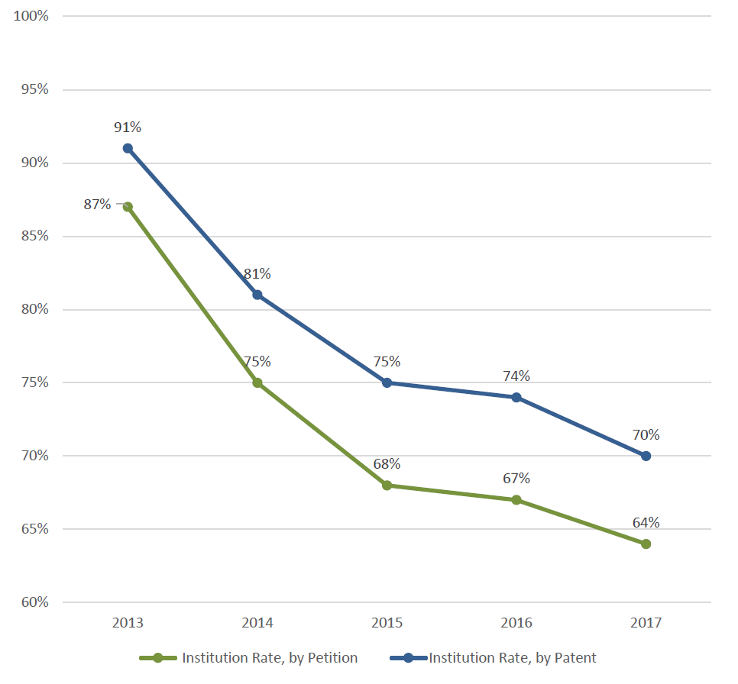
Significant Developments at the PTAB: Guidance on Sections 314(a) and 325(d)
Follow-on petition statistics:
Source: USPTO (as of June 30, 2017)

Slide 17
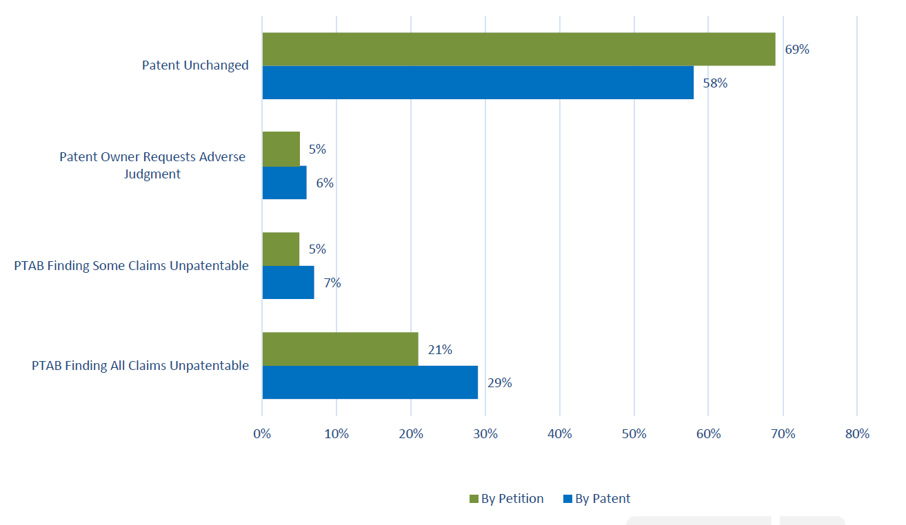
Significant Developments at the PTAB: Guidance on Sections 314(a) and 325(d)
Follow-on petition statistics:
Source: USPTO (as of June 30, 2017)

Slide 18
Significant Developments at the PTAB: Sovereign/Tribal Immunity
Sovereign immunity
Covidien LP v. University of Florida Research Found., Inc., IPR2016-01274, Paper No. 21 (Jan. 25, 2017)
NeoChord, Inc. v. University of Maryland, Baltimore, IPR2016-00208, Paper No. 28 (May 23, 2017)
Reactive Surfaces Ltd. v. Toyota Motor Corp., IPR2016-01914, Paper No. 36 (July 13, 2017)
Tribal immunity
Mylan Pharm. Inc. v. Teva Pharm. USA, Inc., IPR2016-01127 (to be decided)

Slide 19
Significant Developments at the PTAB: Sovereign/Tribal Immunity
Covidien LP (decided January 25, 2017)
Before filing its preliminary response, the patent owner, University of Florida, Research Foundation Inc., filed a motion to dismiss based on sovereign immunity
The Board, relying largely on Fed. Mar. Comm’n v South Carolina State Ports Auth., 535 U.S. 743 (2002), found that sovereign immunity applies to IPR proceedings
The Board found that the patent owner “is an arm of the State of Florida” and dismissed the IPR
“To determine whether an entity is an ‘arm of the State’ in carrying out a particular function, courts look to factors that include: (1) how state law defines the entity; (2) what degree of control the State maintains over the entity; (3) where the entity derives its funds; and (4) who is responsible for judgments against the entity”

Slide 20
Significant Developments at the PTAB: Sovereign/Tribal Immunity
NeoChord, Inc. (decided May 23, 2017)
After oral argument, University of Maryland, Baltimore, and its exclusive licensee, Harpoon Medical, filed a motion to dismiss based on sovereign immunity
The Board reaffirmed that sovereign immunity applies to IPRs
The Board dismissed the IPR
The Board found that the state-affiliated patent owner did not waive sovereign immunity by participating in the IPR proceeding or by granting another party an exclusive license to the patent
The Board found that because the patent owner “retained rights under the license agreement, and transferred less than ‘substantially all’ rights to [the other party],” the patent owner was “a necessary and indispensable party” without which the proceeding could not proceed

Slide 21
Significant Developments at the PTAB: Sovereign/Tribal Immunity
Reactive Surfaces Ltd. (decided July 13, 2017)
After institution, the patent owners, which included Toyota and the Regents of the University of Minnesota, moved to dismiss based on sovereign immunity
Three of the six named inventors assigned their interest to the Regents, the other three assigned their interest to Toyota-affiliated entities
The Board found that the Regents could not be compelled to participate in the IPR because of sovereign immunity
However, the Board found that the proceeding could continue in the Regents’ absence
The Board distinguished NeoChord: “There, the remaining ‘patent owner’ was an exclusive licensee to whom the absent sovereign patent owner had ‘transferred less than ‘substantially all’ rights.’ . . . Here, Toyota is just as much an owner of the ’618 patent as the Regents.”

Slide 22
Significant Developments at the PTAB: Sovereign/Tribal Immunity
Mylan Pharm. Inc. (to be decided)
Involves an attempt to extend the Board’s sovereign immunity doctrine to tribal immunity
The Board sought briefing from amicus curiae in response to a motion to dismiss, indicating that the motion “presents an issue of first impression for the Board”
Fifteen amicus curiae briefs submitted
No immunity / deny motion to terminate*: 8
Immunity applies / dismiss IPR**: 7
* Including request for Board to certify question to Director
** Including lack of Board authority to decide

Slide 23
Agenda
Statistics and Trends
Significant Developments at the PTAB
Guidance From the Federal Circuit
Motions to Amend
APA Challenges
CBM Standing and Reviewability
More to Come From the Supreme Court?
Questions?

Slide 24
Guidance From the Federal Circuit: Motions to Amend
Aqua Prods., Inc. v. Matal, 872 F.3d 1290 (Fed. Cir. 2017)
In a 6-5 vote, the en banc Federal Circuit vacated the PTAB’s final written decision denying Aqua Products’ motion to amend, and remanded the case for the PTAB to issue a final decision assessing the patentability of the proposed substitute claims “without placing the burden of persuasion on the patent owner”
PTAB Guidance
The PTAB issued guidance on November 21, 2017, in view of Aqua Products:
“[I]f a patent owner files a motion to amend (or has one pending) and that motion meets the requirements of 35 U.S.C. § 316(d) . . . the Board will proceed to determine whether the substitute claims are unpatentable by a preponderance of the evidence based on the entirety of the record”
“[G]enerally speaking, practice and procedure before the Board will not change”

Slide 25
Guidance From the Federal Circuit: APA Challenges
EmeraChem Holdings, LLC v. Volkswagen Grp. of Am., Inc., 859 F.3d 1341 (Fed. Cir. 2017)
Background:
The Board issued a final decision that newly relied on specific disclosures in a reference, “Stiles,” in order to hold unpatentable certain dependent claims
Stiles was included in the unpatentability grounds listed in the petition, the specific portion of Stiles relied upon by the Board was block-quoted in the prior art background section of the petition, and the disclosures in Stiles were specifically applied to other claims within the same ground

Slide 26
Guidance From the Federal Circuit: APA Challenges
EmeraChem Holdings, LLC v. Volkswagen Grp. of Am., Inc., 859 F.3d 1341 (Fed. Cir. 2017)
Federal Circuit:
The patent owner was not put on notice that Stiles would be applied to the dependent claims at issue because the highly specific and detailed invalidity contentions in the petition only referenced a different reference (Saito) as disclosing those claims’ features.
Similarly, the court held that the institution decision did not put patent owner on notice because the decision only cited Saito for those claims.

Slide 27
Guidance From the Federal Circuit: APA Challenges
EmeraChem builds on a line of recent APA cases:
The APA’s protections apply to both petitioners and patent owners
SAS Inst., Inc. v. ComplementSoft, LLC, 825 F.3d 1341 (Fed. Cir. 2016)
The Board may not introduce new unexpected prior art arguments or claim construction positions in its final written decision
SAS Inst., Inc. v. ComplementSoft, LLC, 825 F.3d 1341 (Fed. Cir. 2016)
In re Magnum Oil Tools Int’l, Ltd., 829 F.3d 1364 (Fed. Cir. 2016)
The Federal Circuit is unlikely to find APA arguments persuasive if relief is not sought from the Board
Genzyme Therapeutic Prods. Ltd. v. Biomarin Pharm. Inc., 825 F.3d 1360 (Fed. Cir. 2016)

Slide 28
Guidance From the Federal Circuit: APA Challenges
EmeraChem builds on a line of recent APA cases:
Petitioner may not introduce new prior art mappings in its reply or at oral argument
Genzyme Therapeutic Prods. Ltd. v. Biomarin Pharm. Inc., 825 F.3d 1360 (Fed. Cir. 2016)
In re NuVasive, Inc., 841 F.3d 966 (Fed. Cir. 2016)
Dell Inc. v. Acceleron, LLC, 818 F.3d 1293 (Fed. Cir. 2016)
Each proceeding stands on its own
In re NuVasive, Inc., 841 F.3d 966 (Fed. Cir. 2016)

Slide 29
Guidance From the Federal Circuit: CBM Standing and Reviewability
Return Mail, Inc. v. United States Postal Service, 868 F.3d 1350 (Fed. Cir. 2017)
Return Mail argued (among other things) that the Board erroneously found the Postal Service to satisfy the “sued” or “charged with infringement” requirement for a CBM petitioner
Return Mail’s argument forced the Federal Circuit to consider whether it had the authority to review the PTAB’s CBM-standing determination
The Federal Circuit found that it does have that authority

Slide 30
Guidance From the Federal Circuit: CBM Standing and Reviewability
Return Mail, Inc. v. United States Postal Service, 868 F.3d 1350 (Fed. Cir. 2017)
The Federal Circuit distinguished Cuozzo Speed Technologies, LLC v. Lee, 136 S. Ct. 2131 (2016)
“Board’s determination of whether a party is qualified under § 18(a)(1)(B) to petition for CBM review is a condition precedent independent from a threshold analysis regarding the likelihood of success of the information contained in the petition”
The determination is not “a ‘minor statutory technicality’ that can be cured by a more precise or fulsome filing”

Slide 31
Guidance From the Federal Circuit: CBM Standing and Reviewability
Return Mail, Inc. v. United States Postal Service, 868 F.3d 1350 (Fed. Cir. 2017)
The Federal Circuit distinguished Achates Reference Publishing, Inc. v. Apple Inc., 803 F.3d 652 (Fed. Cir. 2015)
The “sued” or “charged with infringement” requirement for CBMs “ensures that CBM review is limited to parties who have some stake in the outcome”
Unlike in Achates, “[i]f a party is barred by § 18(a)(1)(B) from petitioning for CBM review of a patent, it cannot be assumed that the same patent could be challenged by an unrelated third party”
“Unlike the IPR time bar which is simply a procedural requirement that rights be exercised in a timely manner, § 18(a)(1)(B) relates to a party’s right to seek CBM review in the first instance”

Slide 32
Guidance From the Federal Circuit: More to Come From the Supreme Court?
Oil States Energy Services, LLC v. Greene’s Energy Group, LLC (argued November 27, 2017)
Question Presented: “Whether inter partes review—an adversarial process used by the Patent and Trademark Office (PTO) to analyze the validity of existing patents—violates the Constitution by extinguishing private property rights through a non-Article III forum without a jury.”
SAS Institute Inc. v. Matal (argued November 27, 2017)
Question Presented: “Does 35 U.S.C. § 318(a), which provides that the Patent Trial and Appeal Board in an inter partes review ‘shall issue a final written decision with respect to the patentability of any patent claim challenged by the petitioner,’ require that Board to issue a final written decision as to every claim challenged by the petitioner, or does it allow that Board to issue a final written decision with respect to the patentability of only some of the patent claims challenged by the petitioner, as the Federal Circuit held?”

Slide 33
Agenda
Statistics and Trends
Significant Developments at the PTAB
Guidance From the Federal Circuit
Questions?

Slide 34
Thank You!

